Slide 1
A Presentation
On
“Convolution Neural Networks”
Compiled By
Er. Sushil Dyopala
Date: April 21, 2025

Slide 2
Topics
Introduction
CNN Architecture
Convolution Layer
Pooling Layer
Fully Connected Layer

Slide 3
1.0 Convolutional Neural Network
Convolutional Neural Network (CNN) is a class of deep neural networks, most commonly used to process images.
CNNs are highly effective for image classification, object detection, and various computer vision tasks.
In late 1980s, Yann LeCun and Yoshua Bengio introduced the concept of convolutional neural networks.
CNNs are commonly known as ConvNets.

Slide 4
1.1 Convolutional Neural Network: Key Concepts
Local connectivity
Neurons are connected only to a small region of the input.
Parameter sharing
The same filter is applied across different parts of the input.
Hierarchical learning
Extracts low-level features (edges, textures) in early layers and higher-level features (objects) in deeper layers.
Shared Filter/Kernel

Slide 5
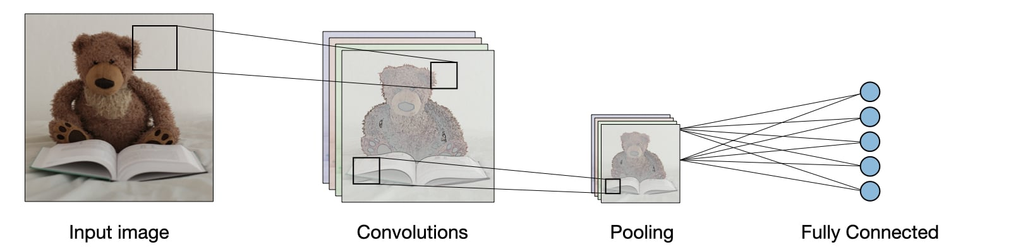
2.0 CNN Architecture
Input Layer: Accepts image data (e.g., 28x28x1 for grayscale).
Convolutional Layer(s): Applies filters to extract features.
Pooling Layer: Reduces dimensionality and computation.
Fully Connected Layer: Acts as a traditional neural network.
Output Layer: Uses softmax or sigmoid for classification.
https://stanford.edu/~shervine/teaching/cs-230/cheatsheet-convolutional-neural-networks

Slide 6
3.0 Convolutional Layers
Convolution Layers are the fundamental building blocks of CNNs.
These layers perform a critical mathematical operation known as convolution.
Convolution uses specialized filters known as kernels, that traverse through the input image to learn complex visual patterns.
The main objective of Convolutional Layers is Feature Extraction.
After every convolution operation, non-linearities is introduced using ReLU activation function.
Kernels
Kernels are small matrices of numbers that move across the image performing element-wise multiplication with the part of the image they cover and add the result, extracting features such as edges, textures, and shapes.

Slide 7
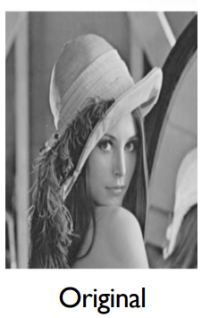
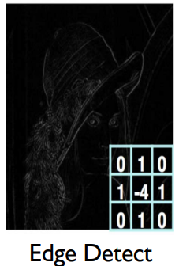
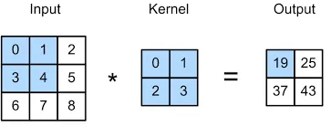
3.0 Convolution Operations
The sliding kernel will detect features from the input image and produces the convolved output.
The output of the convolution operation is called Feature Map and kernel itself is also known as Feature Detector.

Slide 8
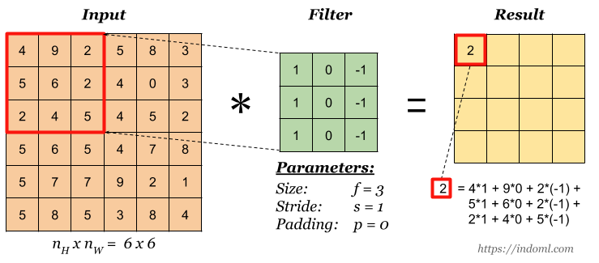
3.1 Convolution Operations: Strides
In a convolution a kernel slides through the pixels of an image.
Stride refers to the number of pixels by which a kernel moves across the input image.

Slide 9
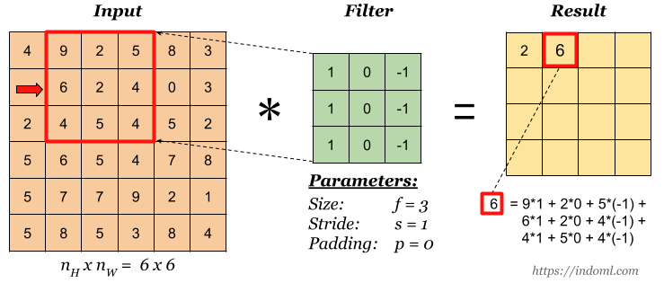
3.1 Convolution Operations: Strides
In a convolution a kernel slides through the pixels of an image.
Stride refers to the number of pixels by which a kernel moves across the input image.

Slide 10
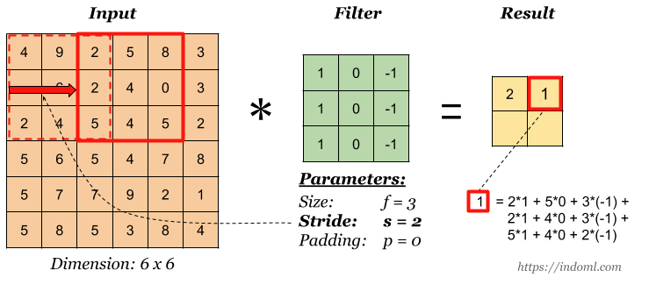
3.1 Convolution Operations: Strides
In a convolution a kernel slides through the pixels of an image.
Stride refers to the number of pixels by which a kernel moves across the input image.

Slide 11
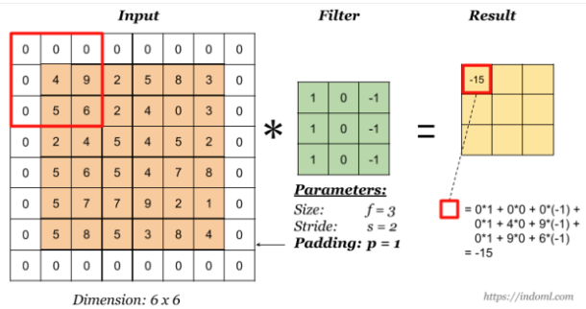
3.2 Convolution Operations: Padding
Padding refers to the addition of extra pixels around the edge of the input image.
Why do we need padding?
It allows us to use a CONV layer without necessarily shrinking the height and width of the image or feature maps.
It helps us keep more of the information at the border of an image. Without padding, very few values at the next layer would be affected by pixels as the edges of an image.

Slide 12
3.3 Convolution Operations in RGB Image

Slide 13
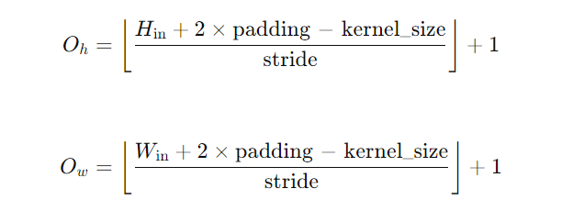
3.4 Convolution Operations: Feature Map Dimensions

Slide 14
3.5 Convolution Operations: Learnable Parameters
We use multiple filters to extract different features.
Learnable Parameters = (K×K×C) × N + N
Where:
K×K = kernel size (e.g., 3×3)
C = number of input channels (e.g., 3 for RGB)
N = number of filters (output channels)

Slide 15
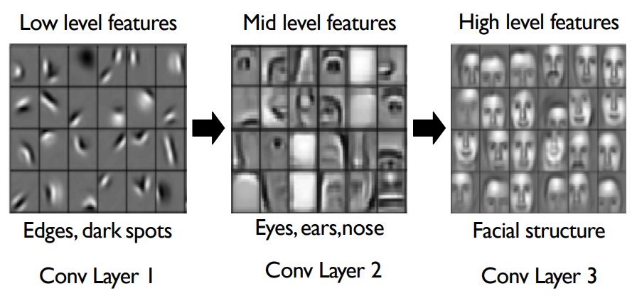
3.6 Convolution Operations: Hierarchical Representations

Slide 16
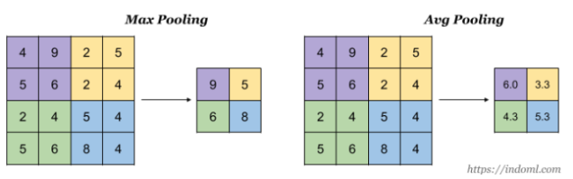
4.0 Pooling Layer
Pooling layer is used to reduce the size of the representations and to speed up calculations.
It has hyper-parameters:
size (f)
stride (s)
type (max or avg)
But it doesn’t have parameter.
Pooling brings positional invariance to small transformations. So, the model can still recognize a feature, even if it appears in a slightly different position in the image.
When done on input with multiple channels, pooling reduces the height and width but keeps number of channels unchanged.

Slide 17
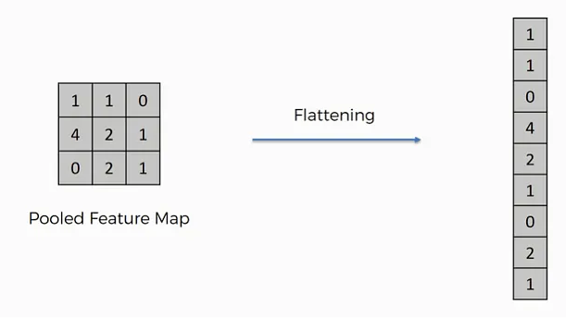
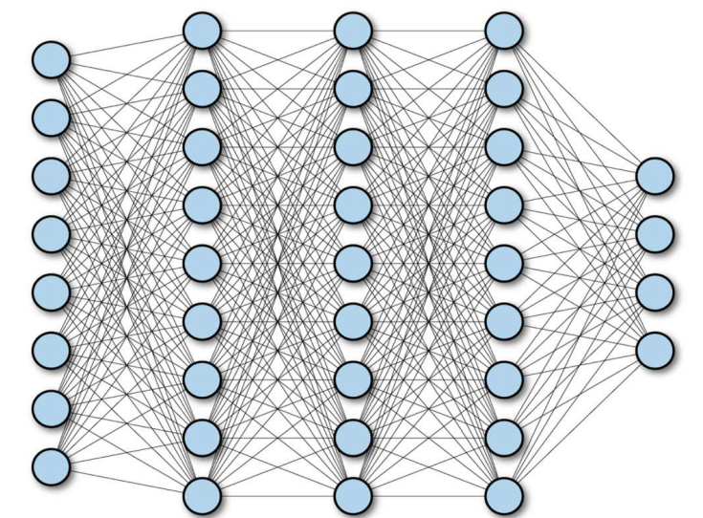
5.0 Fully Connected Layer
After convolutional and pooling layers have extracted relevant features from the input image we have to turn this high-dimensional feature map into a format suitable for feeding into fully connected layers.
Flattening Layer takes the entire feature map and reorganizes it into a single, long vector.
Fully Connected Layer or Dense Layers are essential for integrating these features into predictions.
Each neuron in hidden layer connected to all neurons in input layer.

Slide 18
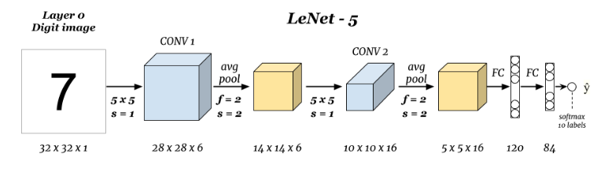
6.0 Putting all Together-ConvNet: LeNet-5

Slide 19
7.0 References
https://stanford.edu/~shervine/teaching/cs-230
https://mit6874.github.io

